Slide 1

Multimodal Personalized Multiuser Home Assistant
Multimodal Interaction,
Project Presentation
Spring 2021
MSc Computer Science
Giulio Attenni & Gabriel Radu Taranciuc

Slide 2






A conceptual proactive Home Assistant that can distinguish people living in the same house

Slide 3
Outline
Concepts
Architecture
Technology
Interactions
Demo
Conclusions and future works

Slide 4
Concepts
Home Assistant:
Device, usually placed in a house, that provides a large variety of services to the users
The interaction is typically conveyed only through the auditory modality
On-the-market home assistants are not aware of the identity of the user
We will try to overcome these two limitations introducing the following new concepts:
For Clan we intend a group of people living in the same house, for example they can be a family or flatmates
For Member we mean a person that is part of the Clan
For Note we intend a virtual sticky notes that a Member can create for one or more recipient in the Clan

Slide 5
Concepts
Detect when a user enters the room using visual input
If possible, recognize the user and initiate interaction
Be able to learn to recognize new users and react to their presence in the future
Let users interact with each other by leaving virtual “sticky notes” that the assistant can output through voice synthetization

Slide 6












Architecture
Desktop Application
Input interface:
visual modality: text input from keyboard, face detection and recognition
auditory modality: speech recognition
Output interface:
visual modality: text shown on screen
auditory modality: voice synthesizers

Slide 7



Technology
A programmable device (laptop or desktop PC) with:
A camera for visual input
A microphone for audio input
Speakers for audio output
Programming language: Python 3.8
Libraries for input processing:
OpenCV (visual input, face detection)
Face_recognition (uses dlib; processing visual inputs)
Pyttsx3 (audio output, works offline)
Speechrecognition (handles audio input, both online and offline)

Slide 8
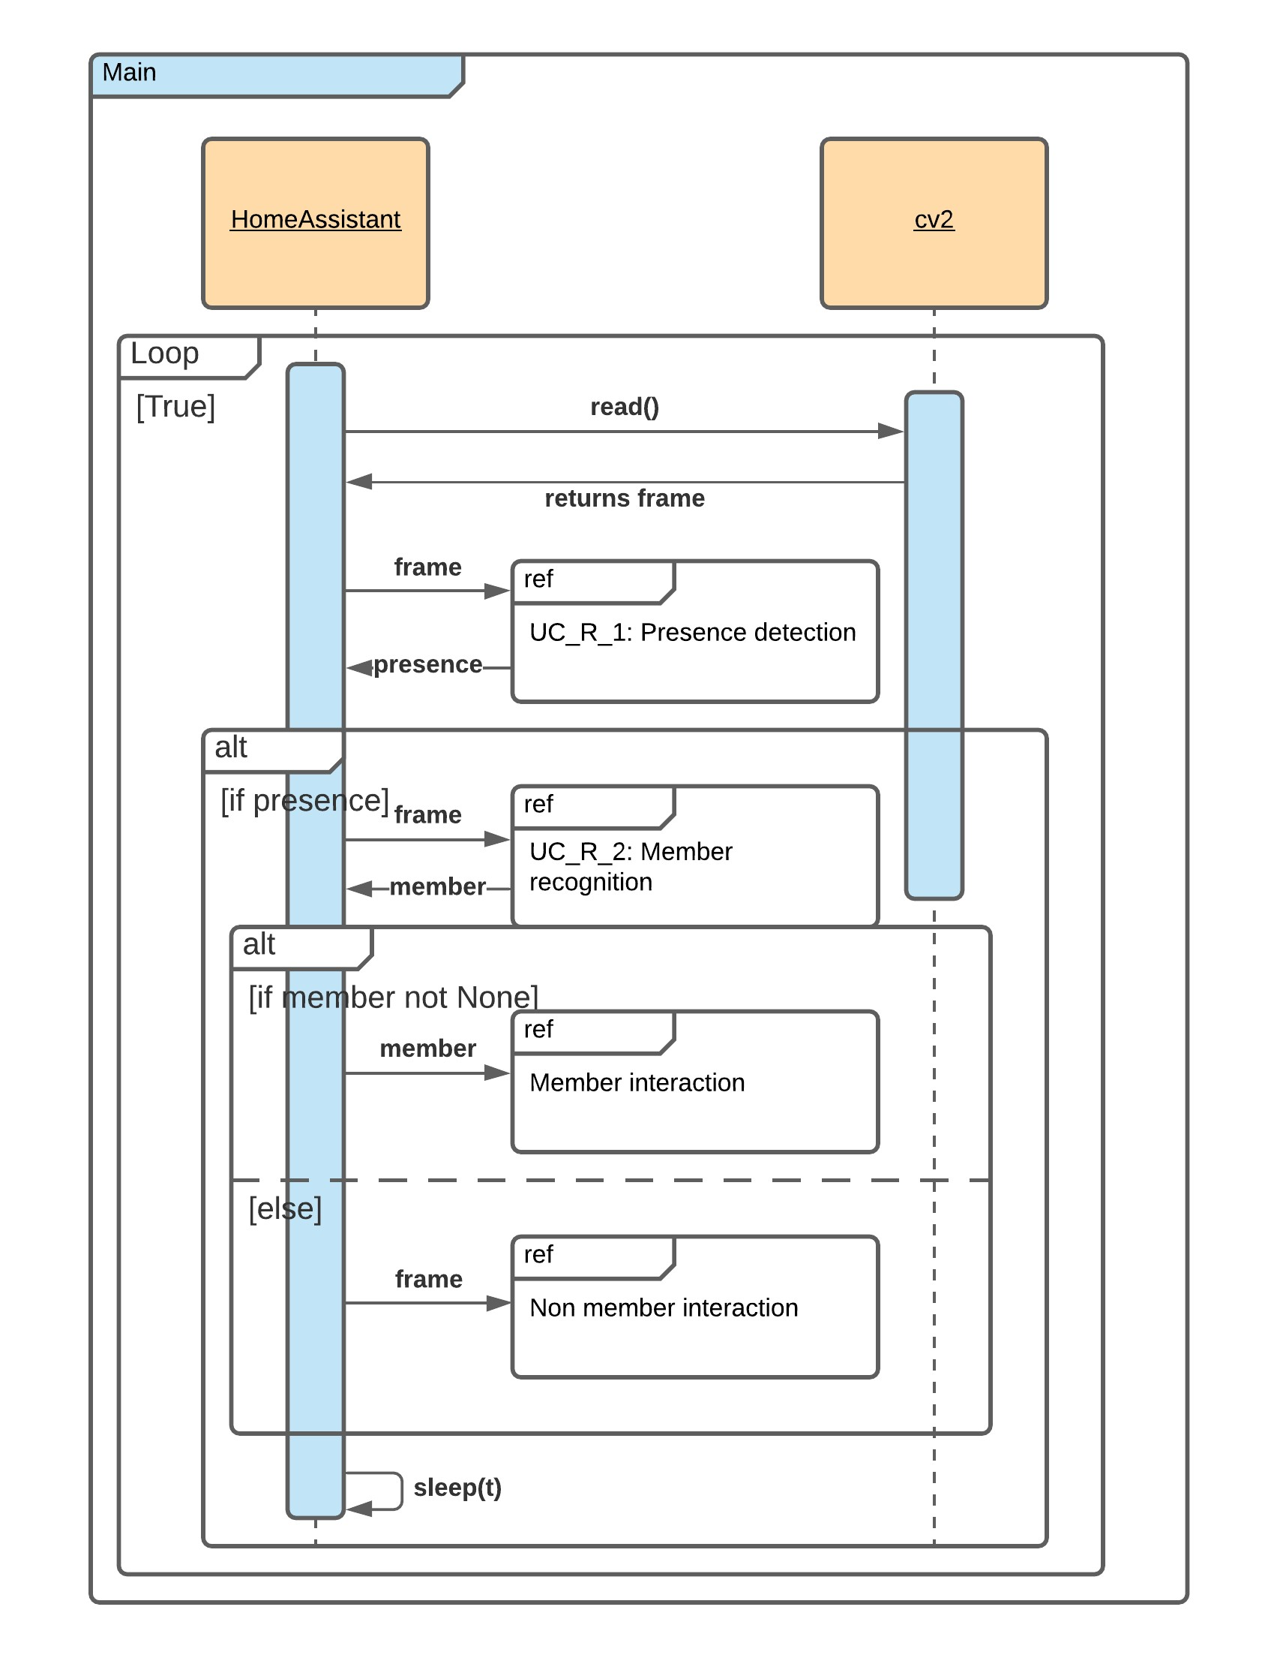
Interactions
Once the device is turned on, it should be placed somewhere where the user wants to be and can be easily identified, recognized and interacted with
The assistant will continuously monitor the camera searching for a successful detection
Steps:
After starting the camera and a periodical sampling of the image received by the camera is performed
Send the captured frame over to the detect_presence method

Slide 9
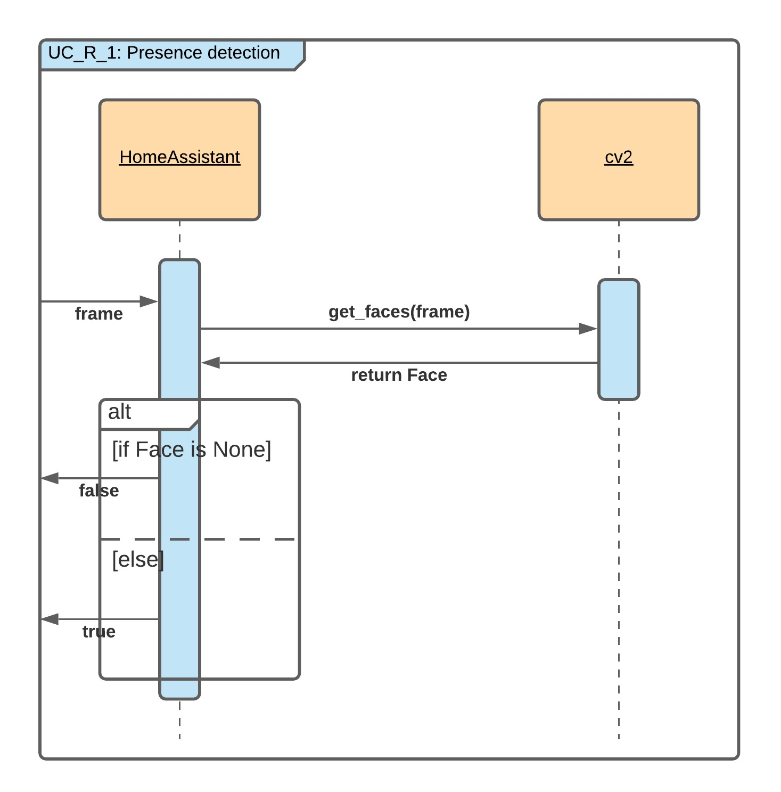
Interactions
Detection Steps:
Converts the frame in B&W
Uses the preloaded opencv CascadeClassifier with Haar Cascades to attempt detection

Slide 10
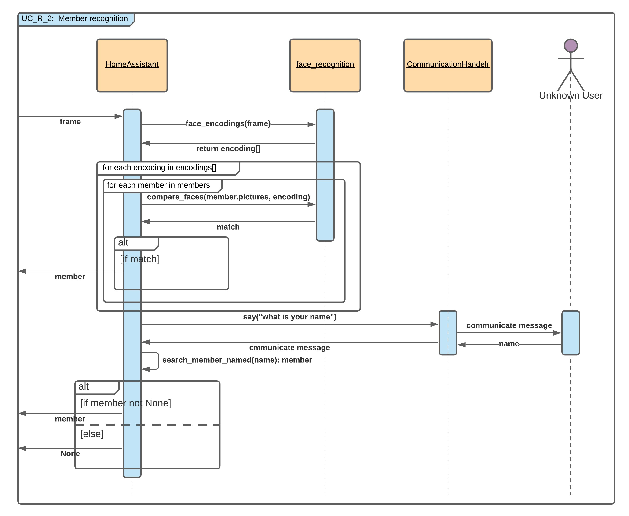
Interactions
Once a face is detected, it attempts to recognize the person
Recognition is performed though image processing
Recognition Steps:
Generate face encodings for each face
Compare each encoding to the ones locally saved for each member until there is a match
If no match is found it asks the person to identify themselves by providing their name

Slide 11
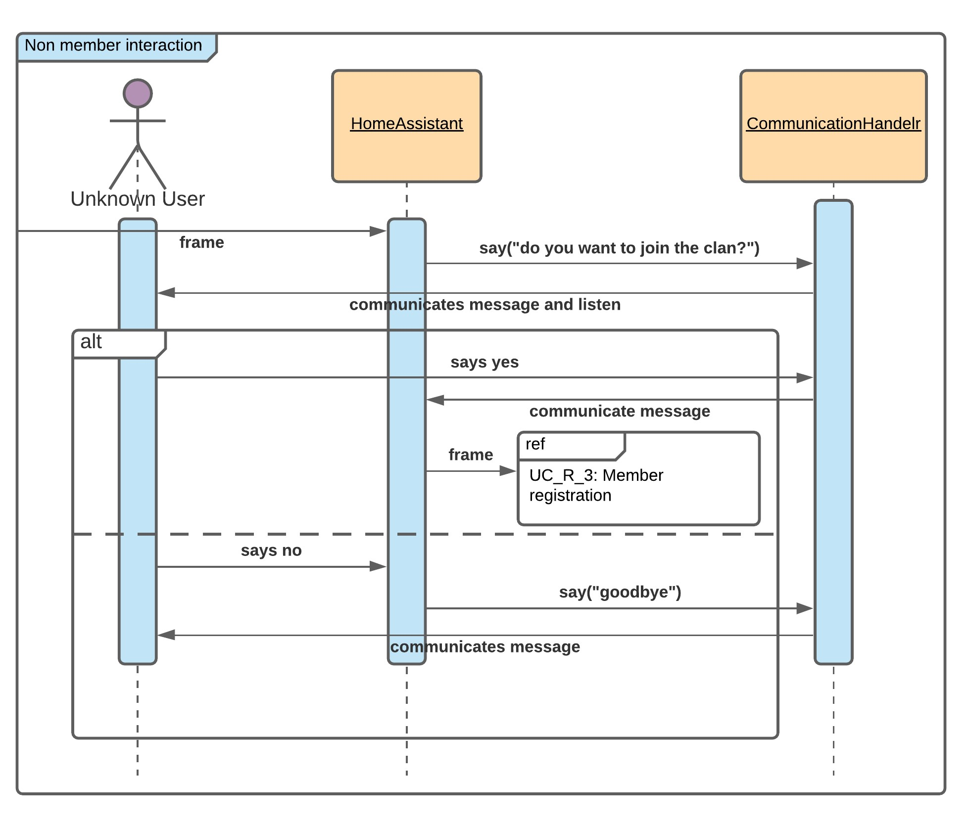
Interactions
Registration Steps:
After recognition fails the assistant attempt the registration of the user
Ask the name which the person wants to register with
Compute face encodings from the detection frame (the frame that started it all)
Create a new instance of the Member class, commit it to memory, and inform the user they are now part of the Clan

Slide 12
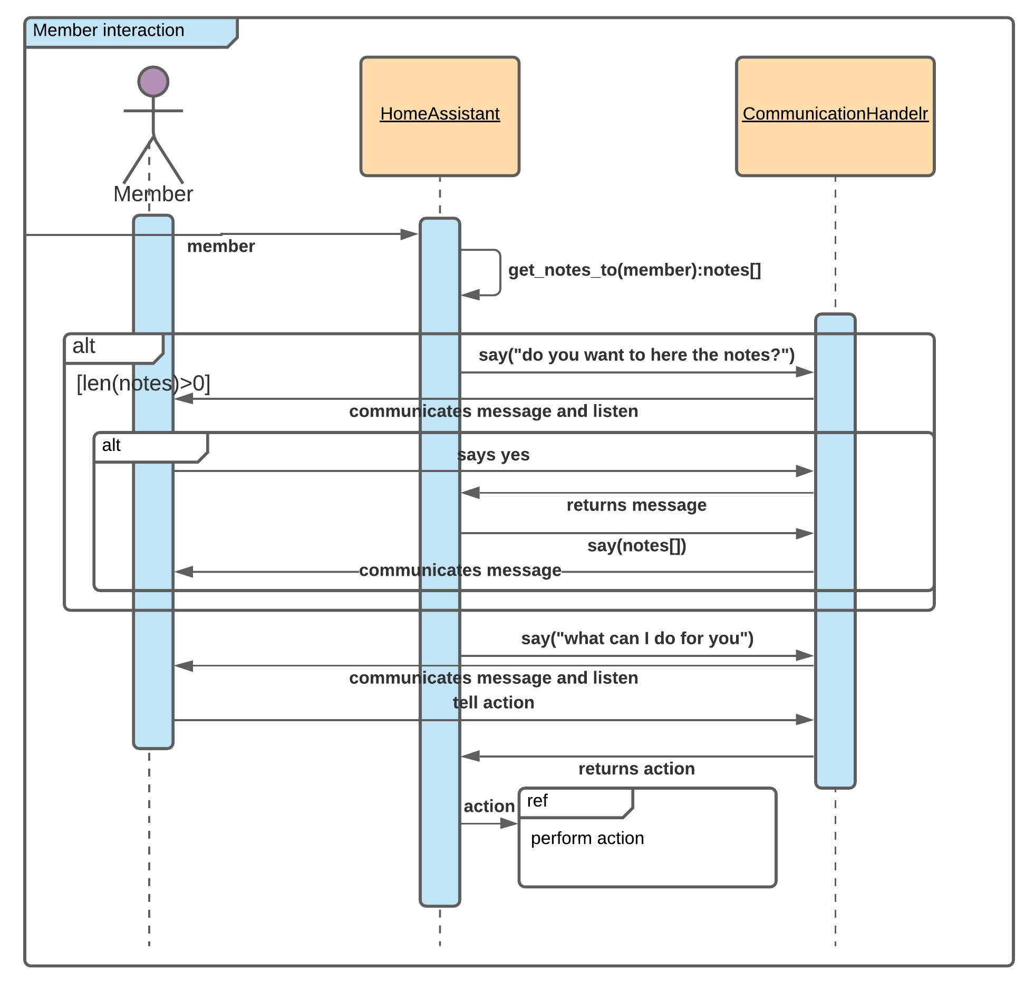
Interactions
The assistant start the interaction greeting the user and informing them of (eventual) pending notes left by other users of the same device
The interaction proceeds with one of the possible actions:
Nuova nota: create a new note
Modifica: edit a previously created note
Rimuovi: remove a previously created note
Termina: stop the interaction
The selection of the action is done with a hot-words based approach that takes into consideration synonyms of words related to the actions

Slide 13
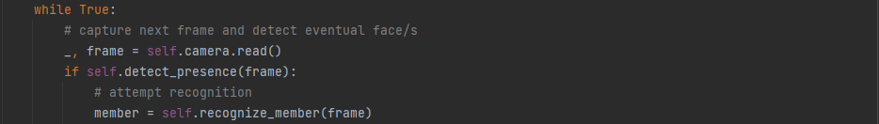
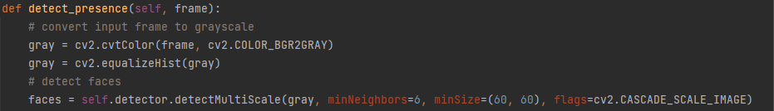
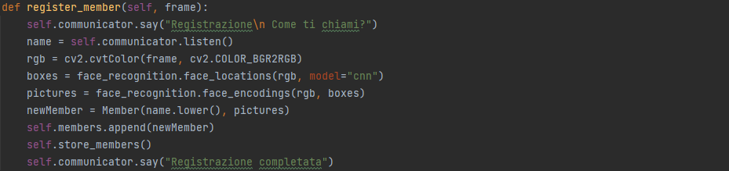
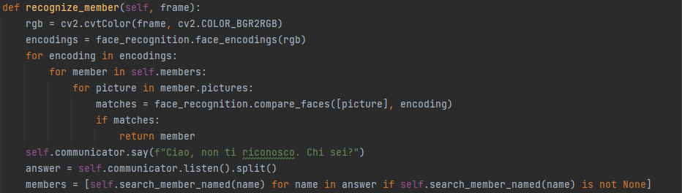
Face Detection & Recognition

Slide 14

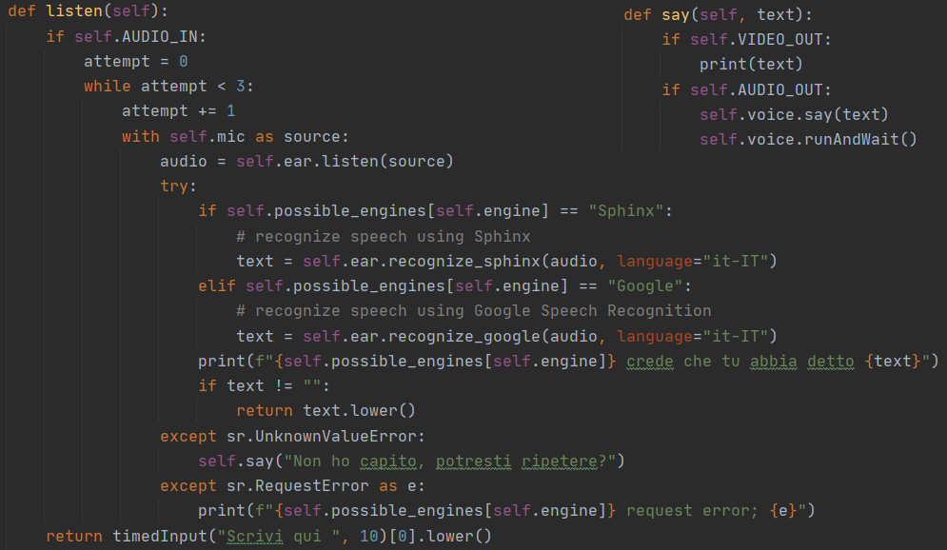
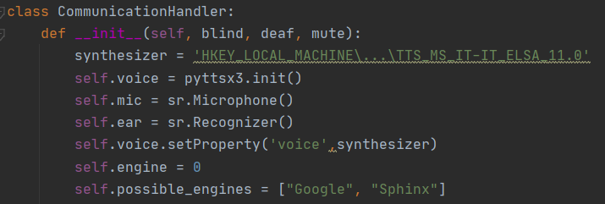
TextToSpeech & SpeechToText

Slide 15
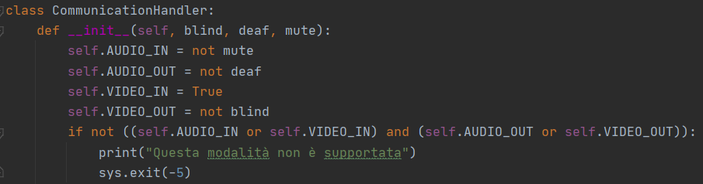
Diversity Aware Developement

Slide 16
Demo

Slide 17
Conclusion and future works
New functionality that overcomes one of the major limitations of present-day home assistants (i.e., personalized multi-user interaction).
New interaction modality has been introduced extending the possible channels through which the interaction is conveyed.
Diversity aware development
Future works:
Exploit visual modality to recognize gesture interactions and sign languages
Exploit auditory modality to recognize members also by voice

Slide 18

Thank you!
Contacts:
@ Giulio Attenni
@ Gabriel Radu Taranciuc
Code repository

